Slide 1
Sudoku Solver
Martin Rode
Marvin Üürike

Slide 2
Outline
Introduction
Approach
Results

Slide 3
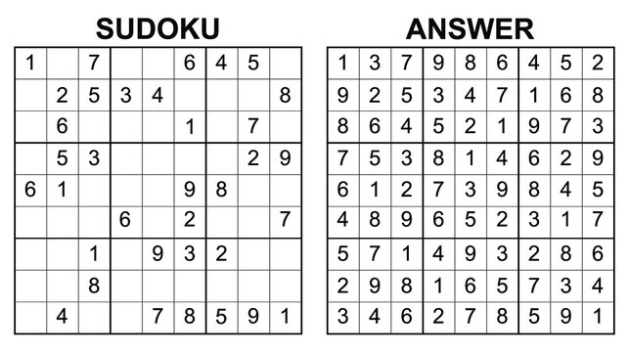
Introduction
HOW…

Slide 4
Approach
Depth First Search – lightweigh, suitable
Strategies:
Basic
Original Legal values
Updating Legal values with Cell Prioritization
Hidden singles with Cell Prioritization
Priority value search

Slide 5
Basic
Try values 1-9 for cells in row-by-row order
1 - check
2 - check
3 - check

Slide 6
Original Legal values
Try legal values for cells in row-by-row order
1 - check
2 - check
3 - check

Slide 7
Updating Legal values with Priority cell search
Updates all legal values each iteration and prioritizes cells with least legal values to try next
3 8 9
2 8 9
2 3 8
2 3 8
9
7
1 6
1 6

Slide 8
Hidden singles
Deep update of legal values cache
3 8 9
2 8 9
2 3 8
2 3 8
9
3 8 9
4 9
8 9
7
3

Slide 9
Priority value search
Try least frequent number first for cells in row-by-row fashion
3 8 9
2 8 9
2 3 8
2 3 8
9
Which number?
3 8 9
4 9
2 count = 3
3 count = 5
4 count = 1
8 count = 6
9 count = 7
II
III
I
IV
8 9
V
7
3 7 9

Slide 10
Results
All approaches were run on 300 “hard” sudokus and number of calls and total solving time was calculated.

Slide 11
Thank you
Q&A

